Slide 1
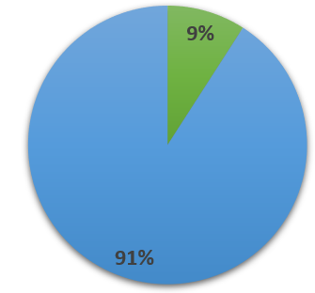
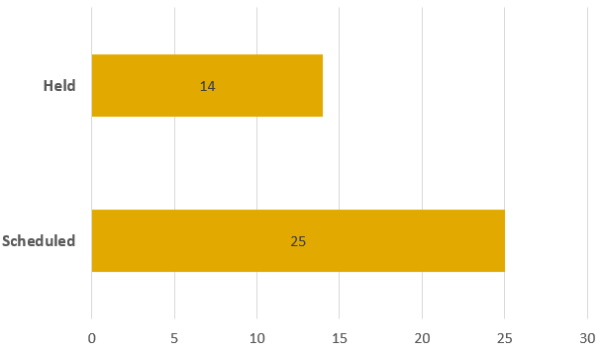
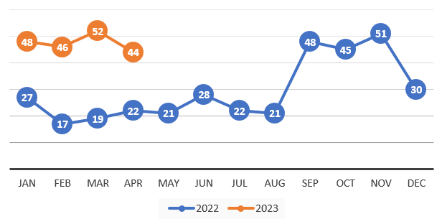
Petition for Medical Treatment Pilot
April 2023 (Collected 5/01/2023)
70.5%
48.4%
Authorized Treatment
29.0%
Denied Treatment
22.6%
In Process
7.0
Average Days Completed
44
Petitions
Filed
CSD Processed
29.5%
47.4%
Resolved Issues
36.8%
Refer to Docket
0.0%
Refer to ADR
15.8%
Hold Status
0.0%
In Process
6.3
Average Days Completed
JUD Referred
Eligible for PMT Pilot
Representation
JUD Teleconferences
Petitions Filed 2022 to 2023
100%
Eligible
91%
Represented by Attorney
Comments:

